Slide 1
Constraints on Hadron Production from the MINOS Near Detector
Žarko Pavlović
FNAL, March 2009

Slide 2
Outline
NuMI beamline, calculating flux and systematic errors
Fitting the ND data (Beam tuning)
Few comments on NuMI offaxis flux
Conclusion

Slide 3
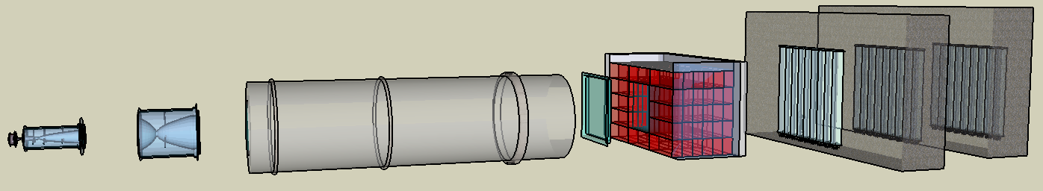
Neutrino Beamline
Muon Monitors
Absorber
Decay Pipe
Horns
Target
μ⁺
ν_{μ}
π⁺
30 m
Hadron Monitor
5 m
Rock
12 m
18 m
10 m
675 m
120 GeV protons
1m long graphite target
2 magnetic horns
Variable beam energy
Beam composition (LE10/185kA):
  92.9% υ_{μ}
  5.8% υ_{μ}
  1.3% υ_{e} / υ_{e}

Slide 4
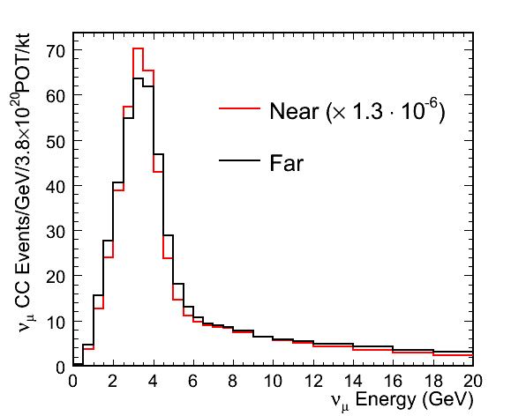
Near and Far Spectra
Flux at Near and Far detector not the same
Neutrino energy depends on angle w.r.t parent momentum
π⁺
to Far
Detector
p
target
(stiff)
π⁺
θ_{f}
θ_{n}
(soft)
Decay Pipe
ND

Slide 5
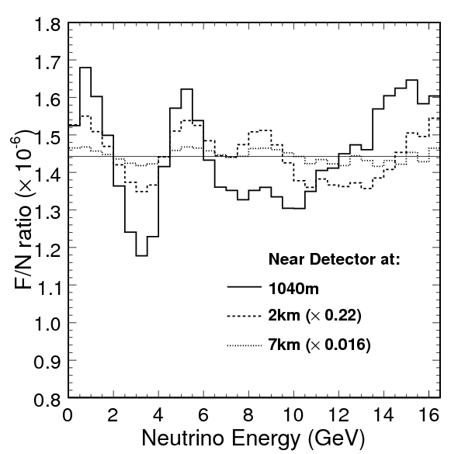
Far over near ratio
20-30% correction on top of R⁻² for ND at ~1km
Need to have detector at 7km to have corrections at 2% level

Slide 6
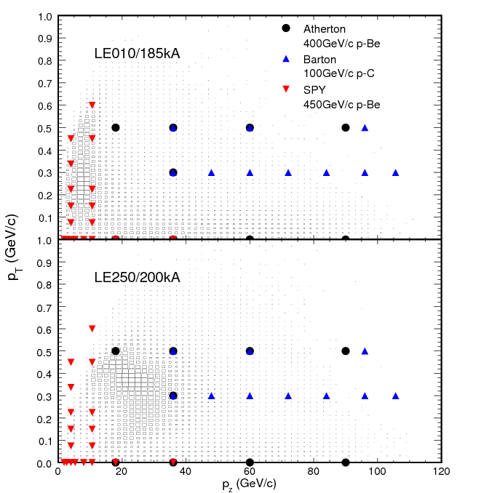
Hadron production
Proton beam momentum
Target material
Thick target

Slide 7
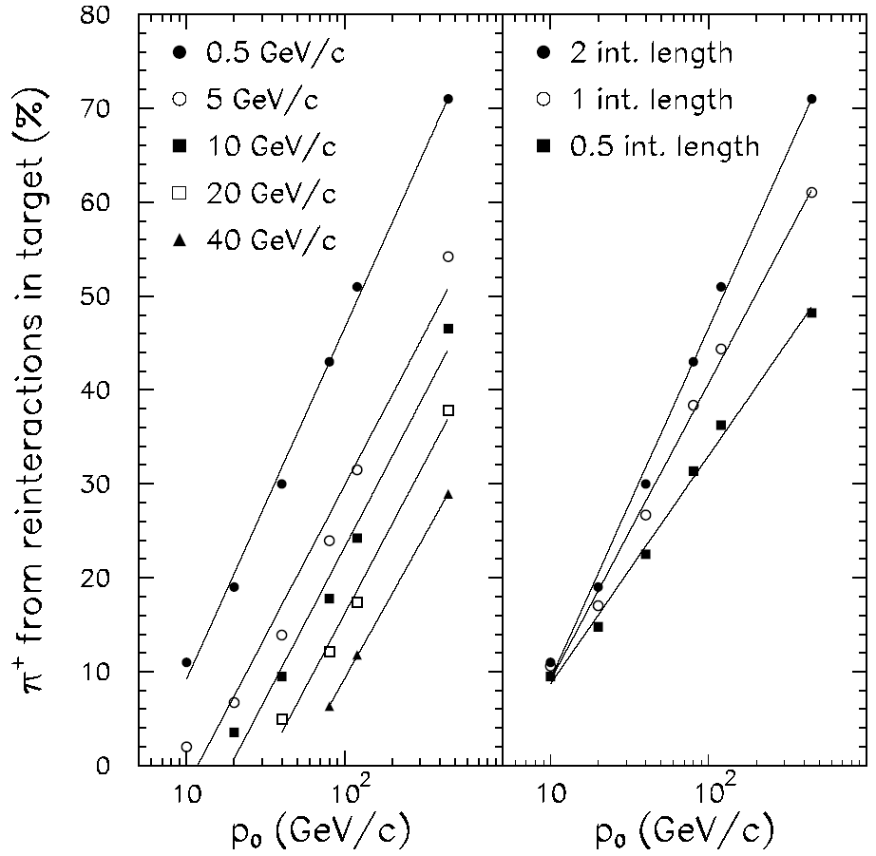
Thick-Target Effects
Hadron production data largely from ‘thin’ targets.
Particles are created from reinteractions in NuMI target.
Approx 30% of yield at NuMI p₀=120 GeV/c
J-PARC
MiniBooNE
CNGS
Fluka 2005
NuMI

Slide 8
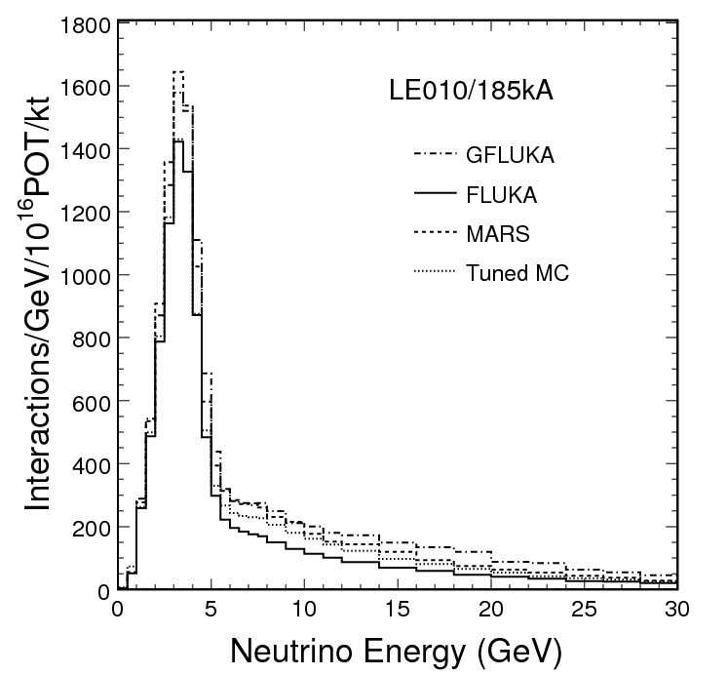
Cascade models
Variation in calculated flux depending on the cascade model
Indicates ~8% uncertainty in peak and ~15% in high energy tail

Slide 9
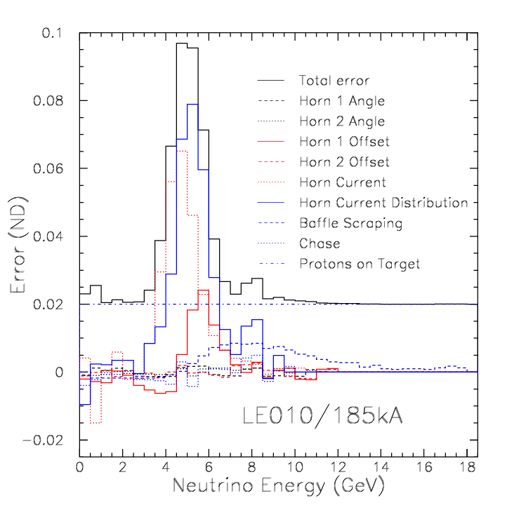
Focusing uncertainties
Misalignments & miscalibrations
Input from beamline instrumentation
Affects falling edge of the peak
Focusing peak

Slide 10
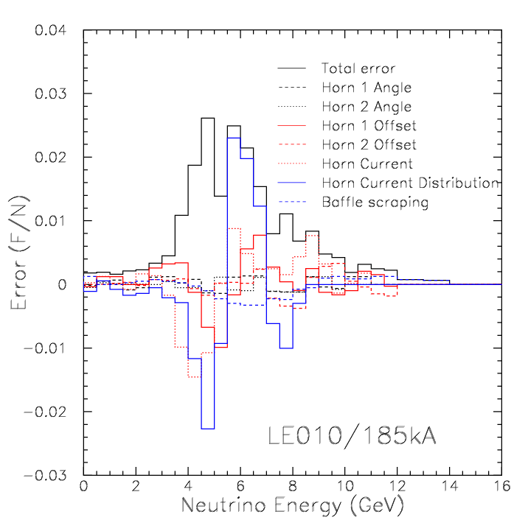
F/N focusing uncertainties
Small effect on Far/Near ratio (2% level)

Slide 11
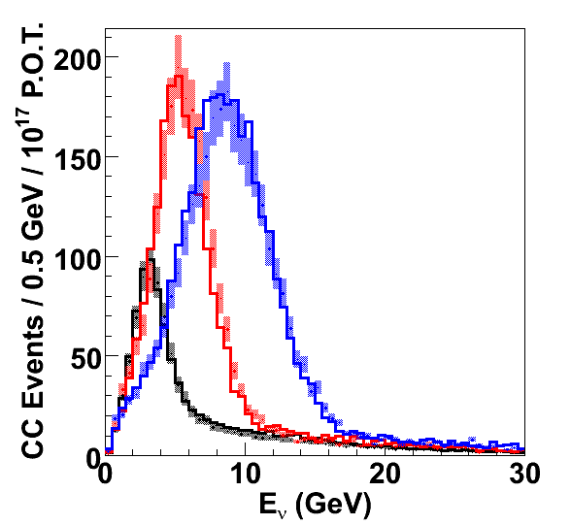
ND Data/MC
MC/Data show some disagreement
Adjust the yields of π± and K±
Fit data from all the beams simultaneously
LE010/185kA
LE100/200kA
LE250/200lA

Slide 12
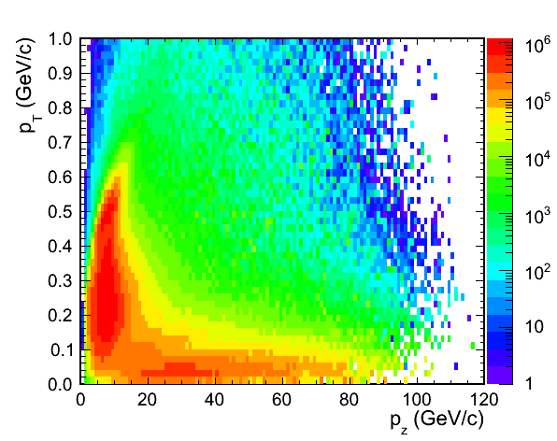
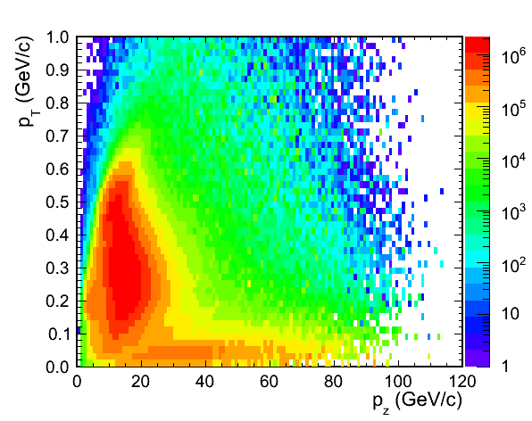
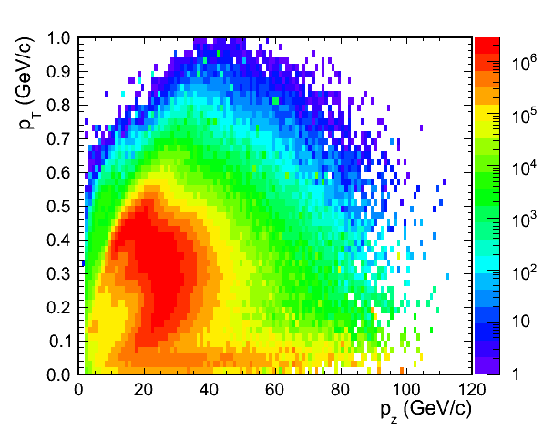
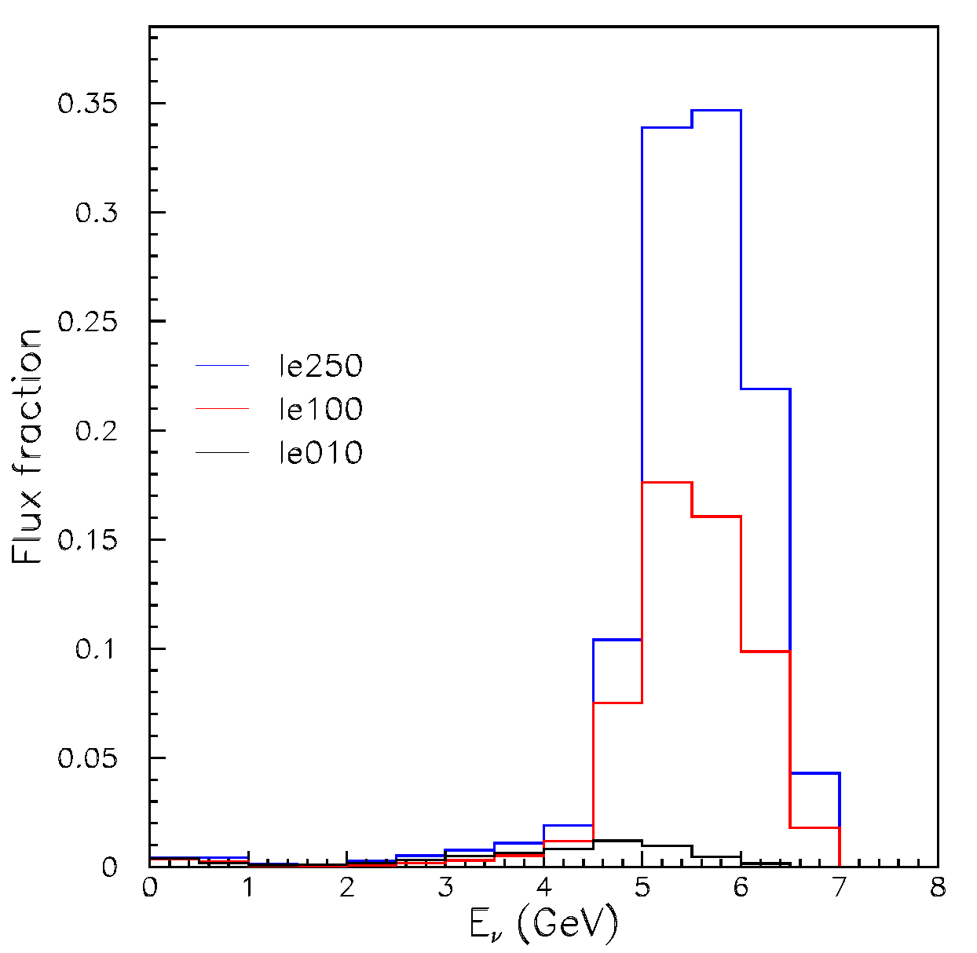
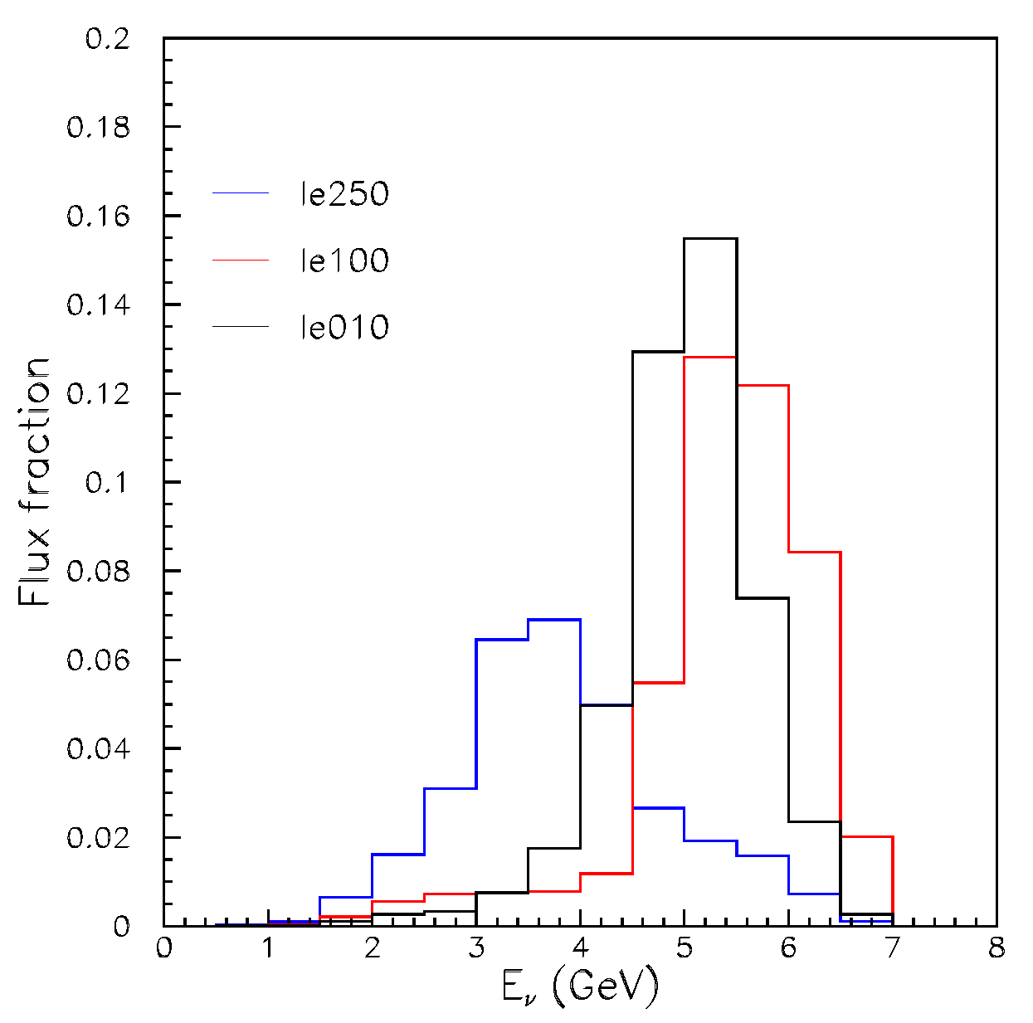
Hadron Production
LE010/185kA
LE100/200kA
LE250/200kA
LE010/185kA
Same p_{T}-x_{F} bin contributes differently to different beams
LE010/185kA
LE100/200kA
LE100/200kA
LE250/200kA
LE250/200kA

Slide 13
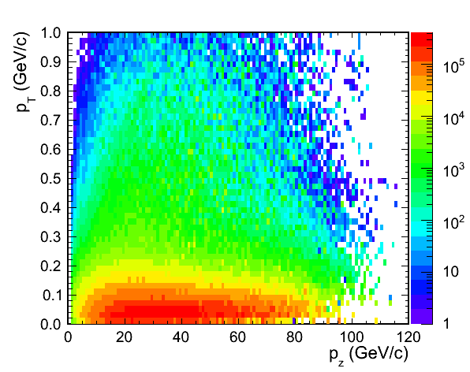
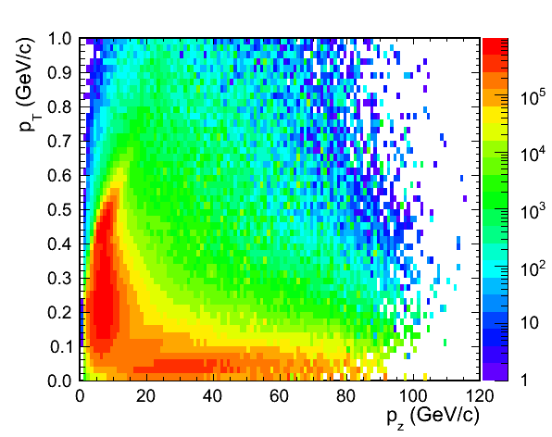
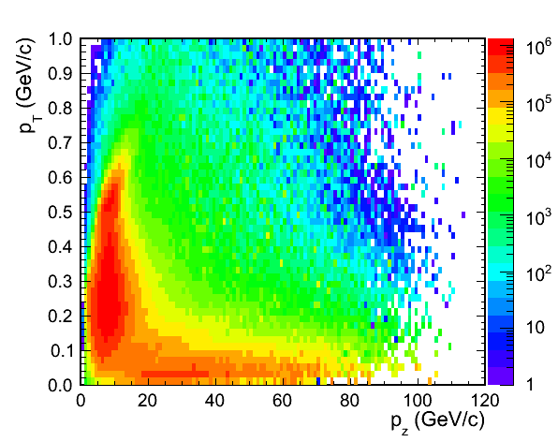
Hadron Production (cont’d)
Different beams sample different pions
  Not shown, but also using data from LE150/200kA
LE010/0kA
LE010/170kA
LE010/185kA
LE010/200kA
LE100/200kA
LE250/200kA

Slide 14
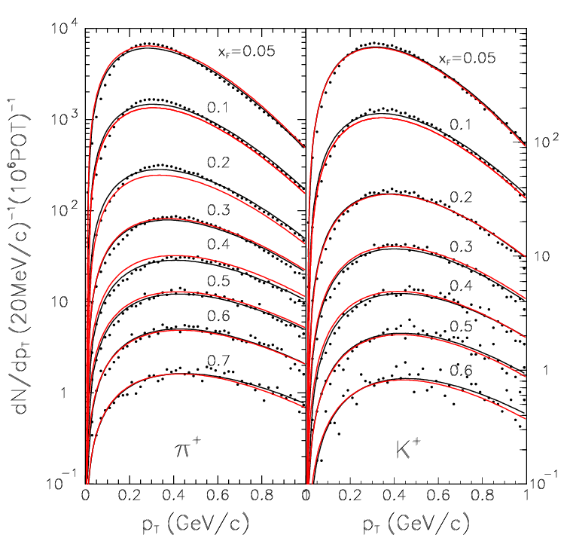
Hadron production parameterization
Adjust yields as a function of p_{T}-p_{z}
Parameterize fluka yields using 16 parameters

Slide 15
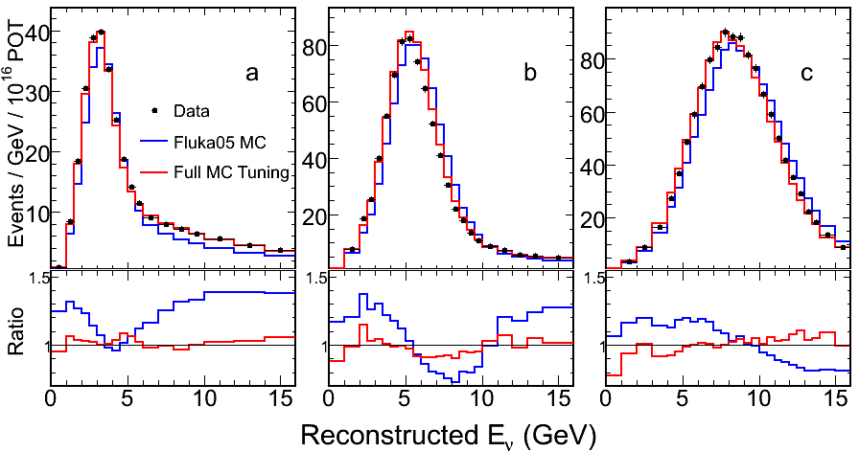
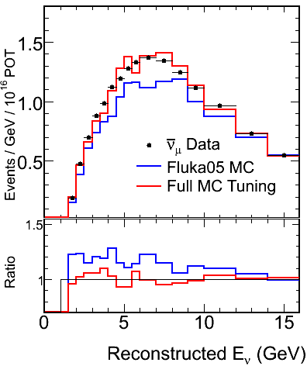
Tuning MC
Fit ND data from all beam configurations
Simultaneously fit ν_{μ} and ν_{μ} spectra
Allow that some discrepancy due to cross sections and detector reconstruction
LE010/185kA
LE100/200kA
LE250/200kA
υ_{μ} LE010/185kA

Slide 16
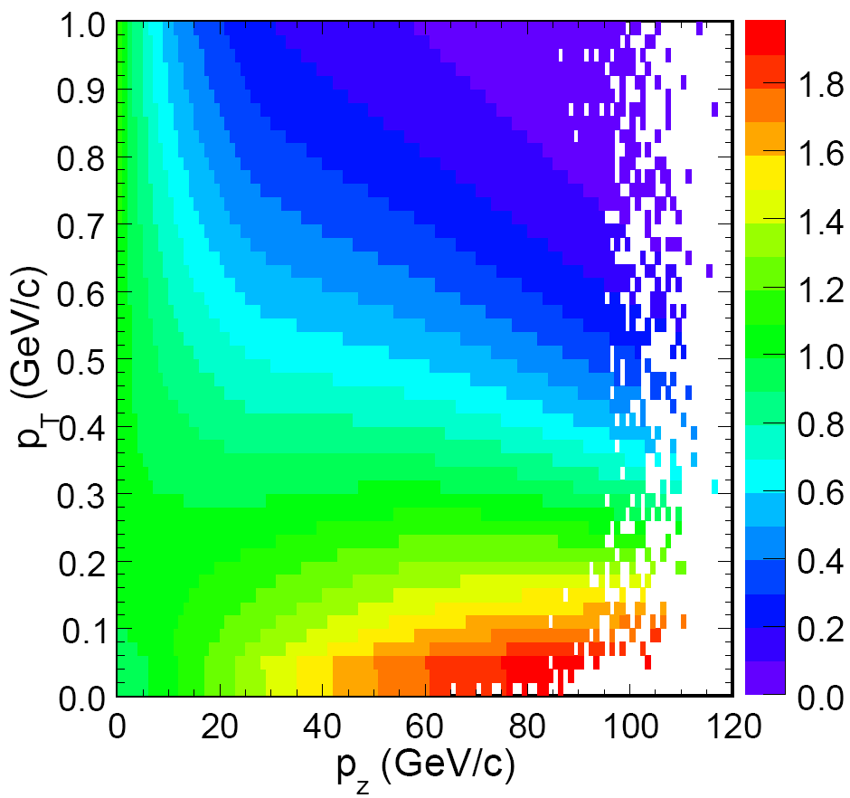
Tuning MC
Adjust the yields of π± and K±
Re-weight MC based on p_{T}-x_{F}
Weights applied
vs p_{z} & p_{T}

Slide 17
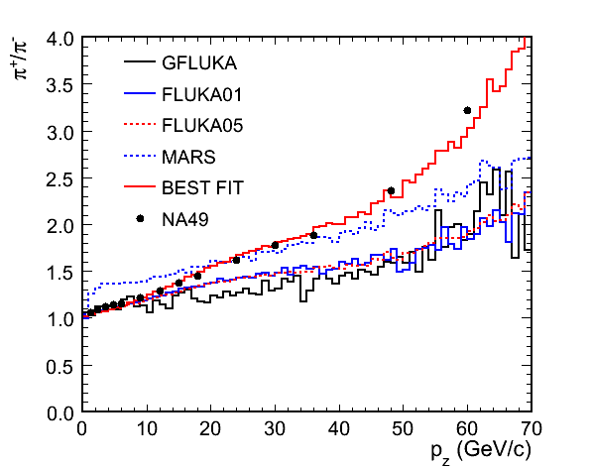
π⁺/π⁻ ratio
Best fit to ν_{μ} and ν_{μ} changes the π⁺/π⁻ ratio
Good agreement with NA49 data and preliminary MIPP results
Notes:
17

Slide 18
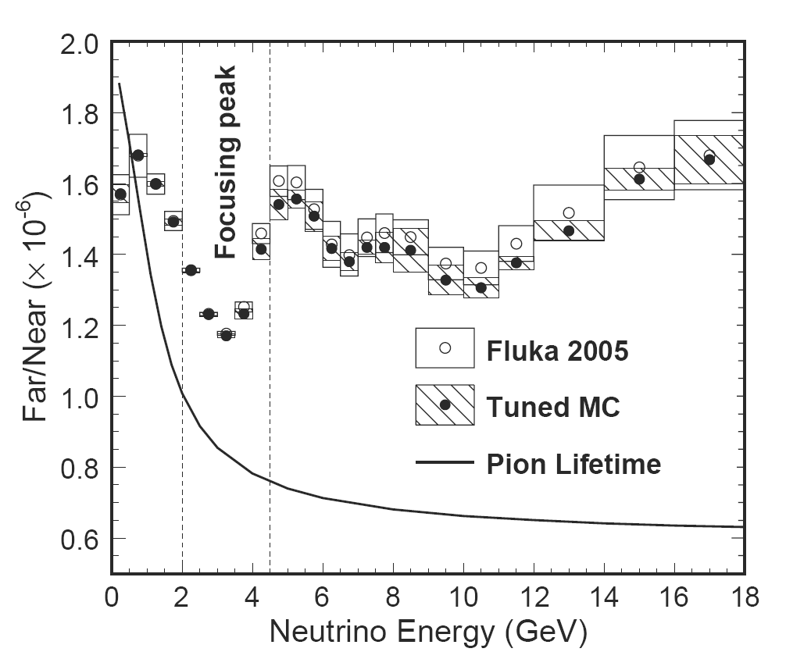
Far/Near Ratio
Constrained hadron production using ND data
Reduced errors on F/N ratio
Systematic error due to beam uncertainty small

Slide 19
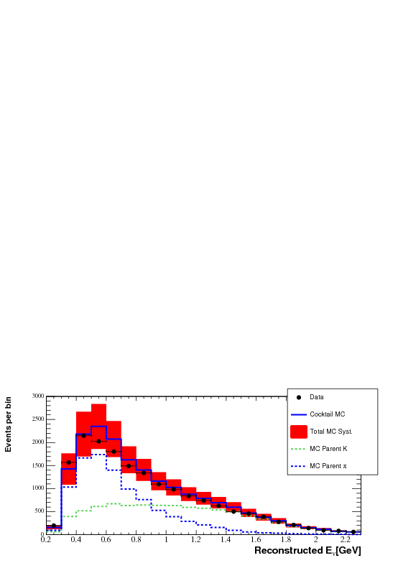
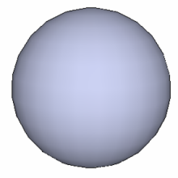
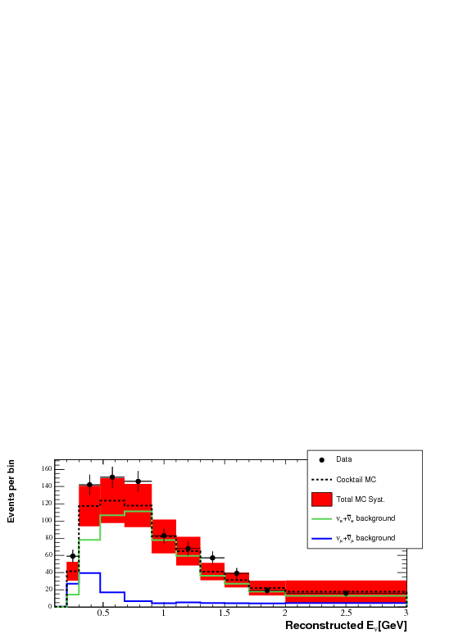
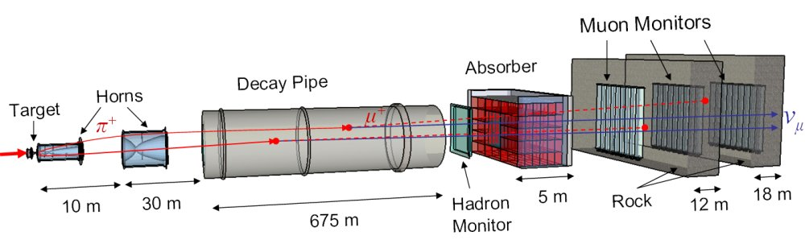
NuMI offaxis beam
MiniBooNE detector sees offaxis neutrinos from NuMI (110mrad)
Good agreement between data and MC
MiniBooNE
diagram not to scale!

Slide 20
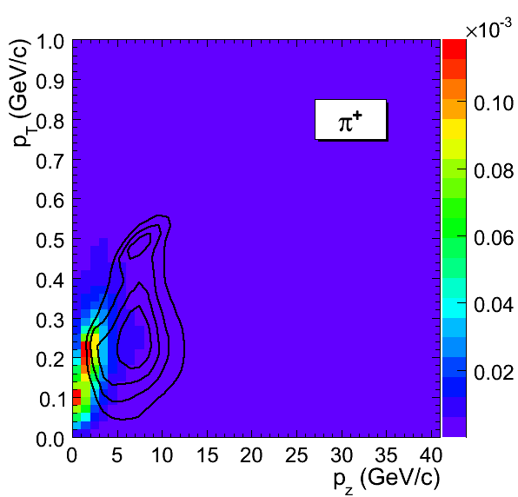
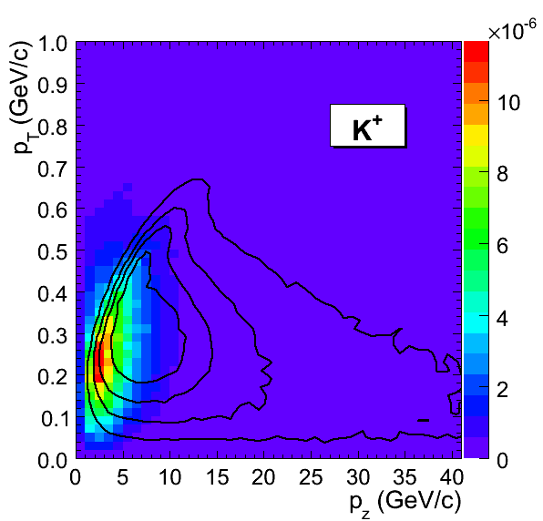
Two views of the same decays
Decays of hadrons produce neutrinos that strike both MINOS and MiniBooNE
Parent hadrons ‘sculpted’ by the two detectors’ acceptances.
Plotted are p_{T} and p|| of hadrons which contribute neutrinos to MINOS (contours) or MiniBooNE (color scale)
MiniBooNE
MiniBooNE
MINOS
MINOS

Slide 21
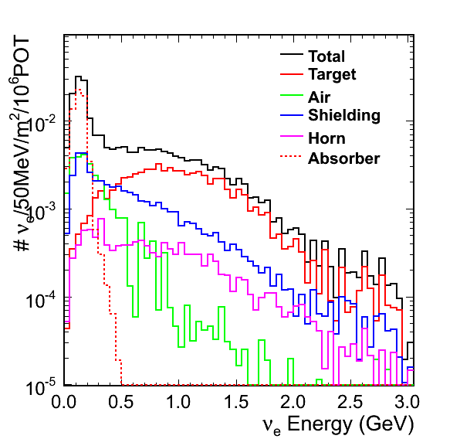
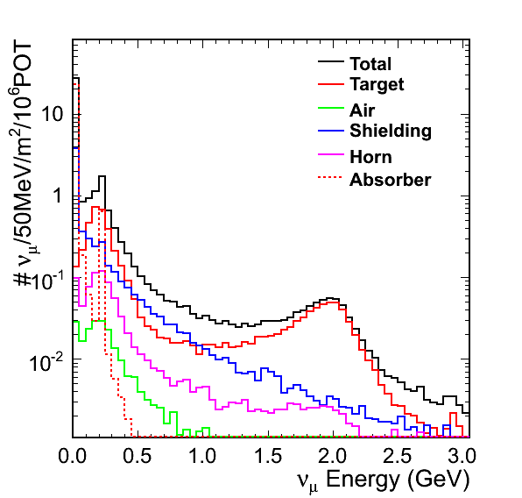
NuMI offaxis beam
ν_{e}
MINOS ND constrains only the target component
Larger error on parents produced in downstream shielding and especially absorber
Excluded neutrinos from absorber in this analysis
ν_{μ}
MiniBooNE
diagram not to scale!
21

Slide 22
Conclusion
Tune hadron production to simultaneously fit all ND data
Technique independent of particle production experiments
Beam systematics well constrained

